Slide 1
Computational Thinking, Problem Solving, and Programming
TOPIC 4.0 – Computational thinking
TOPIC 4
4.1.1 – 4.1.3: Thinking Procedurally

Slide 2
TOPIC 4.1.1 – THINKING PROCEDURALLY
what is AN ALGORITHM anyway?
Formally defined, a list of instructions
Specific instructions
Very little ambiguity
In a specific order
An algorithm is
Finite, it will always end (no infinite algorithm)
Definite, each step is well defined (unambiguous)
Effective, each step is simple

Slide 3
TOPIC 4.1.1 – THINKING PROCEDURALLY
what is AN ALGORITHM anyway?
An algorithm can have
Input that is given to the algorithm
Output that the algorithm gives back
Examples: Recipes, Computer Code (obviously), Lab Instructions
Other examples?

Slide 4
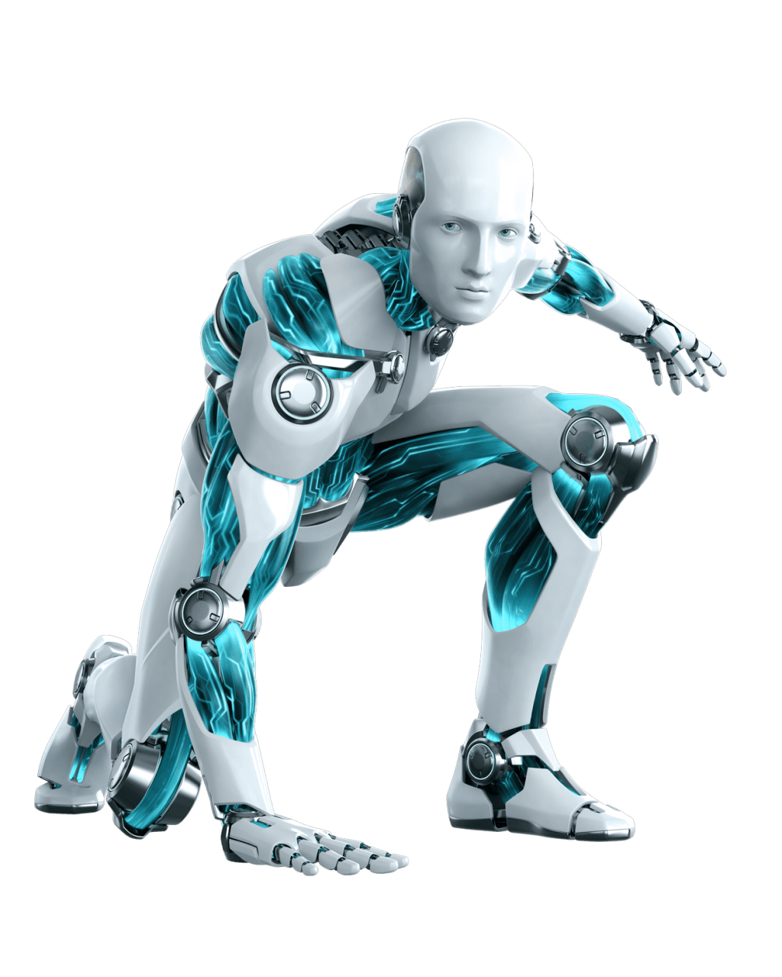
TOPIC 4.1.1 – THINKING PROCEDURALLY
Using the four directions, what combo will get this cool robot PNG* to point A without touching any purple?
 | A
*Assume the robot moves relative to us, and doesn’t turn, and that each square he moves takes one arrow.

Slide 5
TOPIC 4.1.1 – THINKING PROCEDURALLY
What directions will get this cool robot PNG* to point A?
 | A

Slide 6
TOPIC 4.1.1 – THINKING PROCEDURALLY
Just one incorrect instruction can throw off the whole procedure
 | A

Slide 7
TOPIC 4.1.1 – THINKING PROCEDURALLY
NOW, I get jiggy with it
Let’s do some math!! (woo!)
Write an algorithm to solve 7 + 3 * 9 ^ 2
First, we do 9 ^ 2 = 81
Second, we do 3 * 81 = 243
Finally, we do 7 + 243 = 250
This algorithm can compute the answer to our statement
Note the importance of the order
If we don’t specify in our instructions the order, and our reader doesn’t know PEMDAS we would get some wack answers.

Slide 8
TOPIC 4.1.1 – THINKING PROCEDURALLY
NOW, WE get jiggy with it
Let’s do some more math! (double woo!)
Do the same thing, but for (9 + 3) * 5 * (5 – 2)

Slide 9
TOPIC 4.1.1 – THINKING PROCEDURALLY
NOW, YOU get jiggy with it
Don’t worry, the math is almost over!
Do the same thing, but for (8 ^ 3 * 2) – 5

Slide 10
TOPIC 4.1.2 – THINKING PROCEDURALLY
TRUE OR FALSE
Will the following algorithm correctly solve 5 + 1 + 4 * 3 ^ 4?
First, 3 ^ 4 = 81
Second, 4 * 81 = 324
Third, 5 + 1 = 6
Finally, 6 + 324 = 330

Slide 11
TOPIC 4.1.3 – THINKING PROCEDURALLY
TRUE OR FALSE
How about this: 5 + 10 * 8 ^ 2?
First, 10 * 8 = 80
Second, 80 ^ 2 = 1600
Finally, 5 + 1600 = 1605

Slide 12
TOPIC 4.1.1 – THINKING PROCEDURALLY
Algorithms appendix
Additional notes:
For many problems, multiple algorithms can solve the problem
Algorithms can be written a few ways
English words/instructions
Flow chart
Pseudo-code
Code

Slide 13
TOPIC 4.1.1 – THINKING PROCEDURALLY
Flowchart:
Algorithms appendix
Start
Declare y = x ^ 2
An algorithm to give me x ^ 2 multiplied by 3
Declare z = y * 3
English:
First, calculate x ^ 2, and call it y
Second, calculate y * 3, and call it z
Return z
Return z
Start

Slide 14
TOPIC 4.1.1 – THINKING PROCEDURALLY
Algorithms appendix
An algorithm to give me x ^ 2 multiplied by 3
Pseudocode:
//assume x already exists
y = x * x
z = y * 3
output z
Python code
def func(x):
y = x * x
z = y * 3 return(z)

Slide 15
TOPIC 4.1.1 – THINKING PROCEDURALLY
what is A PROGRAM?
All this talk of algorithms is fun, but isn’t computer science about making programs?
A program:
Generally, a collection of algorithms
Created to solve a specific problem or set of problems
Or be Twitter I guess

Slide 16
TOPIC 4.1.1 – THINKING PROCEDURALLY
THINK LIKE A COMPUTER
How do I know when to make an algorithm?
When you have a problem, and you need to identify a specific solution
Solution can be comprised of simple, repeatable steps
Steps are able to be followed in a certain order

Slide 17
TOPIC 4.1.2 – THINKING PROCEDURALLY
THINK LIKE A COMPUTER
Order of steps in an algorithm is important
I can’t bake a cake before I’ve mixed my batter
Think about what steps you’ll need before you make the whole algorithm

Slide 18
TOPIC 4.1.3 – THINKING PROCEDURALLY
PROCEDURES
These algorithms can get repetitive, huh?
Procedures allow us to cut down on repeat steps in an algorithm or program.
‘Jump’ to another algorithm (called a procedure) to shorten and simplify our program.
Also known as ‘sub-procedures’

Slide 19
TOPIC 4.1.3 – THINKING PROCEDURALLY
PROCEDURE EXAMPLE
Let’s say I’m a robot that can cook, and I need specific instructions on how to do each step of the process.
Algorithm for cracking eggs looks like this
Grab egg from the egg carton
Locate a suitable surface to crack the egg on
Gently, yet firmly hit the egg against the surface
Split the egg apart using the crack generated by hitting it against the surface
Pry the egg open all the way, releasing the whites and the yolks into the bowl
That’s a lot of steps, right??
Some of these recipes have to crack tons of eggs!

Slide 20
TOPIC 4.1.3 – THINKING PROCEDURALLY
PROCEDURE EXAMPLE
If I’m making a cake that takes 3 eggs, my algorithm looks like this JUST for the eggs:
Grab egg from the egg carton
Locate a suitable surface to crack the egg on
Gently, yet firmly hit the egg against the surface
Split the egg apart using the crack generated by hitting it against the surface
Pry the egg open all the way, releasing the whites and the yolks into the bowl
Grab egg from the egg carton
Locate a suitable surface to crack the egg on
Gently, yet firmly hit the egg against the surface
Split the egg apart using the crack generated by hitting it against the surface
Pry the egg open all the way, releasing the whites and the yolks into the bowl
Grab egg from the egg carton
Locate a suitable surface to crack the egg on
Gently, yet firmly hit the egg against the surface
Split the egg apart using the crack generated by hitting it against the surface
Pry the egg open all the way, releasing the whites and the yolks into the bowl
(This is obviously way too long just for some eggs)

Slide 21
TOPIC 4.1.3 – THINKING PROCEDURALLY
PROCEDURE EXAMPLE
Unique procedure for cracking an egg
CrackEgg():
Grab egg from the egg carton
Locate a suitable surface to crack the egg on
Gently, yet firmly hit the egg against the surface
Split the egg apart using the crack generated by hitting it against the surface
Pry the egg open all the way, releasing the whites and the yolks into the bowl
Name of procedure is important
Main algorithm looks for that name in your program to run the procedure

Slide 22
TOPIC 4.1.3 – THINKING PROCEDURALLY
PROCEDURE EXAMPLE
Now, if our cake cracks three eggs, all we need is:
CrackEgg()
CrackEgg()
CrackEgg()
Benefits:
Save time writing the algorithm
Save space on paper or inside the computer

Slide 23
TOPIC 4.1.3 – THINKING PROCEDURALLY
PROCEDURE BENEFITS
Benefits:
Save time writing the algorithm
Save space on paper or inside the computer
Compare this to actions you have memorized or do on instinct.
You don’t usually have to remember each step to:
Tie your shoes
Walk (foot by foot)
Get into your car

Slide 24
TOPIC 4.1.3 – THINKING PROCEDURALLY
Algorithm EXERCISE
Write an algorithm for something you’re familiar with, in plain words.
Be sure not to leave any steps out, be specific, like you’re writing it to a child. You can’t assume they know anything about what you’re doing.
Use at least one procedure, and write it like this
ProcedureName():
Procedure step 1
Procedure step 2
Procedure step 3
Then use that procedure in your algorithm by writing it in like this
Algorithm step 1
ProcedureName()
Algorithm step 2

